Slide 1
SESSION 01
Large Language Models & Generative AI
From Transformers to LLaMA to Prompt Engineering
Notes:
Welcome students. Frame the session as one continuous story: from what an LLM is, through how modern LLMs are built and made efficient, to how we control them with prompts.
1

Slide 2
01 · WHAT IS AN LLM?
What is an LLM?
Large
Language
Model
Billions of parameters, trained on massive text corpora.
Operates on human language — text goes in, text comes out.
A statistical function mapping input tokens to output probabilities.
Notes:
Quick refresher, not a first exposure — they've seen Transformers before. Emphasize the three words: Large (parameter scale + training data), Language (text in, text out), Model (a statistical function).
2

Slide 3
01 · WHAT IS AN LLM?
The core idea
"The cat is sitting on the ___"
mat
62%
chair
21%
floor
11%
rug
6%
An LLM predicts the next token based on the tokens that came before it.
Notes:
This is the single idea everything else builds on. Walk through the probability bars — the model doesn't 'know' the answer, it ranks candidates.
3

Slide 4

01 · WHAT IS AN LLM?
Autoregressive generation
Prompt
→
Predict token
→
Append token
→
Repeat ↻
The
cat
is
sitting
on
the
mat
Each new token is generated one at a time and appended to the growing sequence.
Notes:
Walk the loop: predict, append, repeat. This loop is the reason generation is inherently sequential — which matters later for the cost discussion.
4

Slide 5
01 · WHAT IS AN LLM?
LLMs operate on tokens
un
believ
able
"unbelievable" → 3 tokens
Not raw words — sub-word pieces the model was trained to split text into.
Context length is measured in tokens: a hard limit on how much the model can see at once.
Every token processed costs compute — more tokens, higher inference cost.
Notes:
Point out this connects directly to the cost story: more tokens = more compute, and context length is a hard ceiling on what the model can see.
5

Slide 6
01 · WHAT IS AN LLM?
Tokenization techniques
TECHNIQUE
UNIT
VOCABULARY SIZE
UNSEEN WORDS
Word-level
Whole words
Very large
Fails — out-of-vocabulary
Character-level
Single characters
Tiny
Always handled, long sequences
Subword (BPE / WordPiece)
Frequent sub-word units
Moderate
Handled by splitting into pieces
Modern LLMs use subword tokenization — a fixed, manageable vocabulary that can still represent any word by breaking rare ones into familiar pieces.
Notes:
Subword tokenization is the reason 'unbelievable' split the way it did on the last slide — walk the table left to right and land on why modern LLMs use subwords.
6

Slide 7
01 · WHAT IS AN LLM?
Controlling the next token
Temperature
Top-K
Scales the probability distribution before sampling — low values stay predictable, high values allow riskier tokens.
Restricts sampling to the K most likely next tokens, discarding the long tail.
Top-P (nucleus)
Max tokens
Samples from the smallest set of tokens whose combined probability passes P.
Caps how many tokens the model is allowed to generate before it stops.
Same next-token distribution as before — these parameters decide how it gets sampled.
Notes:
These knobs act on the same probability distribution from the last slide — tie each one back to the mat/chair/floor/rug bars before moving on.
8

Slide 8
01 · WHAT IS AN LLM?
Phases of training an LLM
Pretraining
→
Fine-tuning
→
RLHF
Pretraining
Fine-tuning
RLHF
Next-token prediction over massive raw text — this is where general language and world knowledge come from.
Further training on curated instruction/task examples so the model learns to follow requests.
Human feedback shapes a reward signal that steers the model toward helpful, safe responses.
Notes:
Set the scope: this session focuses on how the model runs at inference — but it's worth being clear on how it got its behavior in the first place. Don't dwell — this is context, not the core material.
9

Slide 9
02 · TRANSFORMER → MODERN LLMS
From NLP to LLMs
RNN
→
LSTM / GRU
Transformer
→
BERT / GPT
→
Modern LLMs
→
Modern LLMs build on the Transformer's parallel attention mechanism, not on recurrence.
Notes:
Move fast through RNN/LSTM — they know this. The point is that the Transformer's parallel attention is what unlocked scale.
7

Slide 10
02 · TRANSFORMER → MODERN LLMS
Transformer refresher
Self-attention
Multi-head attention
Each token weighs every other token to build a context-aware representation.
Several attention "views" run in parallel, each capturing different relationships.
Positional information
Encoder / decoder
Order is injected explicitly — attention alone has no sense of sequence.
Encoders read context; decoders generate output one token at a time.
Notes:
This is a recap, not new material — move quickly through the four boxes and confirm nothing is unfamiliar before moving on.
10

Slide 11
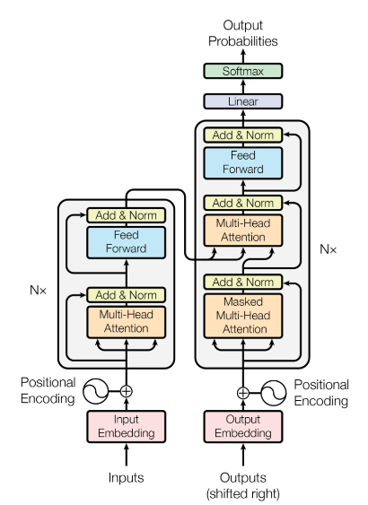
02 · TRANSFORMER → MODERN LLMS
The Transformer, from the paper
Notes:
Ground the refresher in the real figure — point out the encoder stack (left) and decoder stack (right) matching what was just reviewed.
11

Slide 12
02 · TRANSFORMER → MODERN LLMS
What becomes expensive when we scale autoregressive Transformers?
Generating token N needs information from every token before it — and that computation repeats at every step.
Notes:
Pose this as a genuine question to the room before answering it on the next slides. Avoid framing the Transformer as flawed — frame it as a scaling challenge.
12

Slide 13
03 · KV CACHE
The inference bottleneck
Token 1
t1
Token 2
t1
t2
Token 3
t1
t2
t3
Token 4
t1
t2
t3
t4
Without caching, generating each new token recomputes attention over every token that came before it (muted chips).
Notes:
This is the visual that should make the redundancy click before we name the fix. Every row recomputes the muted tokens from scratch.
13

Slide 14
03 · KV CACHE
What is KV Cache?
Previous tokens
Compute K, V
Store in cache
→
→
New token
Compute new Q
Reuse cached K, V
Attention output
→
→
→
Attention uses Query, Key, and Value — the Key and Value of past tokens don't change once computed.
They can be stored and reused instead of recomputed at every step.
Notes:
Name the fix. Emphasize: Key and Value representations of past tokens never change once computed — only Query is new each step.
14

Slide 15
03 · KV CACHE
Why KV Cache matters
Less redundant computation per generated token.
Faster token generation, especially over long sequences.
Better overall inference efficiency.
Trade-off: KV Cache consumes GPU memory.
Notes:
Three clean wins, then the tradeoff. Land on the tradeoff — it sets up the rest of the section.
15

Slide 16
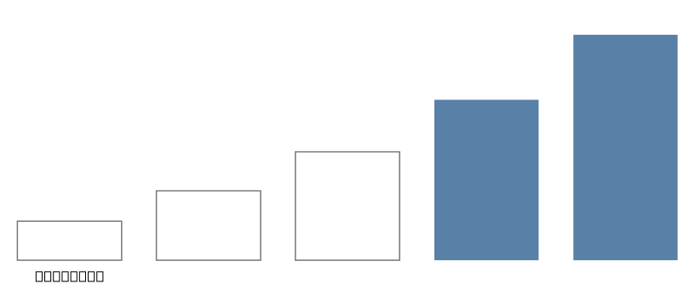
03 · KV CACHE
Why it becomes a problem at scale
Long context windows
Large models — more layers, more heads
Multiple simultaneous users being served
Notes:
Each factor multiplies memory: longer context, bigger models, more heads, more concurrent users. This motivates GQA in the next section.
16

Slide 17
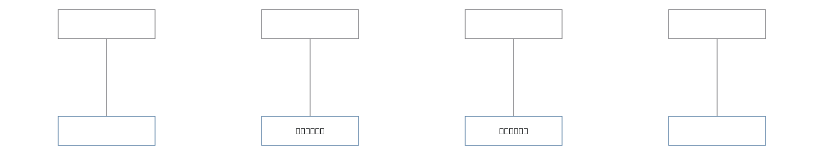
04 · GROUPED QUERY ATTENTION
Multi-Head Attention
Every query head has its own key/value head — full quality, and the largest KV-cache footprint.
Notes:
Standard MHA: every query head gets its own dedicated key/value head. Best quality, largest cache.
17

Slide 18
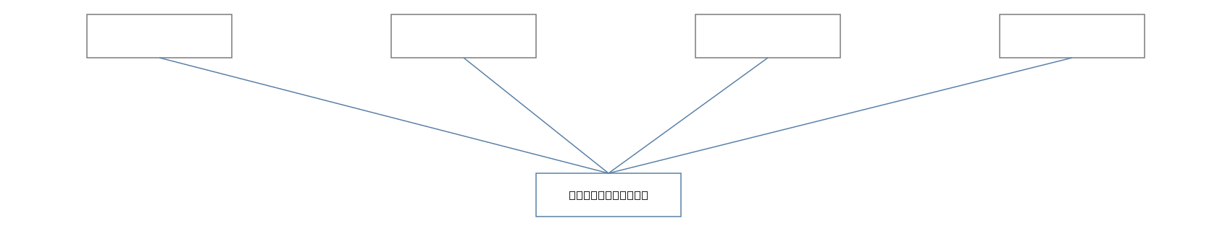
04 · GROUPED QUERY ATTENTION
Multi-Query Attention
All query heads share one key/value head — minimal KV-cache size, at a quality cost.
Notes:
MQA collapses all K/V heads into one. Cheapest cache, but note the quality tradeoff before moving to GQA.
18

Slide 19
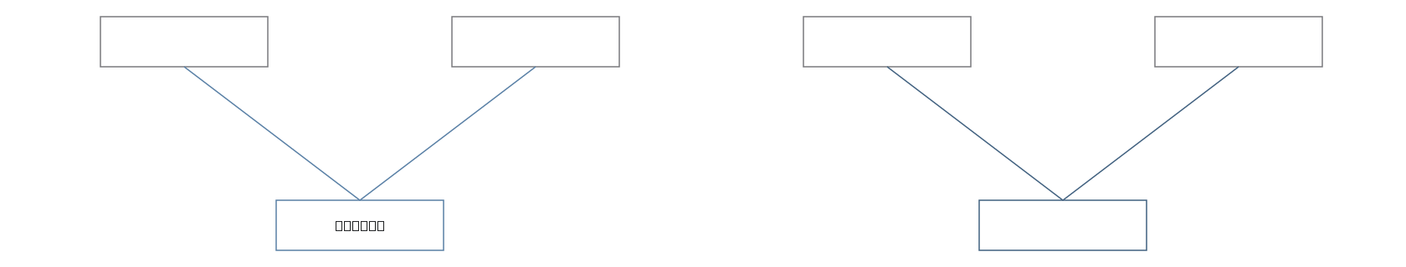
04 · GROUPED QUERY ATTENTION
Grouped Query Attention
Multiple query heads share a smaller number of key/value heads — a middle ground between MHA and MQA.
Notes:
GQA is the compromise: groups of query heads share a KV head. This is what most modern LLMs actually ship.
19

Slide 20
04 · GROUPED QUERY ATTENTION
MHA vs MQA vs GQA
ARCHITECTURE
Q HEADS
KV HEADS
KV-CACHE MEMORY
MHA
Many
Many
High
MQA
Many
1
Low
GQA
Many
Some
Medium
GQA is the compromise: most of MHA's quality, closer to MQA's memory footprint.
Notes:
Read the table left to right, then land on GQA as the practical compromise most current models choose.
20

Slide 21
04 · GROUPED QUERY ATTENTION
Why GQA matters for modern LLMs
Lower KV-cache memory per request.
Better serving efficiency on the same hardware.
Allows scaling to larger models, longer contexts, and more concurrent requests.
Notes:
Tie it back to serving: this is what lets a model handle more users and longer context at the same hardware budget. Avoid overstating exact numbers.
21

Slide 22
05 · LLAMA & MODERN ARCHITECTURE
LLaMA as a real example
A modern, decoder-only LLM architecture from Meta.
Modern LLMs are not simply "the original Transformer, copied directly."
LLaMA combines targeted refinements — the next slide shows where.
Notes:
Set up that LLaMA is real evidence of these ideas combined — not a re-derivation of the original 2017 Transformer.
22

Slide 23
05 · LLAMA & MODERN ARCHITECTURE
LLaMA architecture overview
Modern components
Tokens
↓
RoPE
Token embeddings
↓
RMSNorm
Transformer blocks
↓
SwiGLU
Self-attention
↓
Feed-forward network
Causal attention
↓
Output probabilities
GQA (in later generations)
Notes:
Walk the pipeline top to bottom, then the tags on the right. Note that GQA applies to some LLaMA generations, not all — don't overclaim.
23

Slide 24
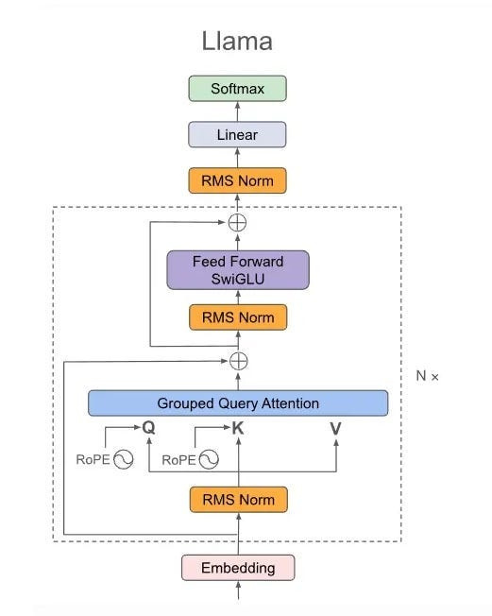
05 · LLAMA & MODERN ARCHITECTURE
LLaMA, from the paper
Touvron et al. — "LLaMA: Open and Efficient Foundation Language Models"
Notes:
The full figure the previous slide's crops were pulled from — use it to point out where each labeled component sits in context.
24

Slide 25
05 · LLAMA & MODERN ARCHITECTURE
Big picture recap
Tokens
Decoder-only Transformer
Self-attention
KV Cache (inference)
Next-token probabilities
→
→
→
GQA
→
→
→
Generated text
Notes:
This is the technical section's recap slide — walk the whole chain once, slowly, before pivoting to prompting.
26

Slide 26
06 · PROMPT ENGINEERING
We understand how the model generates text. How do we control what it generates?
Prompt Engineering
Notes:
This is the pivot slide for the second half of the session. Give it a beat before moving on.
27

Slide 27
06 · PROMPT ENGINEERING
What is Prompt Engineering?
Designing instructions, context, and constraints that guide an LLM toward the desired output.
Simple prompt
Precise prompt
Write about dogs.
Write a 100-word paragraph for a 5th-grade science class explaining why dogs have such a strong sense of smell.
Notes:
Define it simply, then let the two boxes do the teaching — a vague prompt vs a precise one, same task.
28

Slide 28
06 · PROMPT ENGINEERING
Anatomy of a good prompt
Role
Task
Context
Who the model should act as.
What it should actually do.
Background it needs to know.
Constraints
Examples
Output format
Limits — length, tone, scope.
Sample inputs/outputs to follow.
Bullets, table, JSON, and so on.
Not every prompt needs every component.
Notes:
Six ingredients — emphasize that not every prompt needs all six. This is a checklist, not a template.
29

Slide 29
06 · PROMPT ENGINEERING
Zero-shot, few-shot, CoT, ToT
Zero-shot
Few-shot
Classify this review as positive or negative.
"The battery life is disappointing."
"Fast shipping!" → positive
"Broke after a week." → negative
"Great value for the price." → positive
"The battery life is disappointing." → ?
Chain-of-thought
Tree-of-thought
Q: A train travels 60 mph for 2.5 hours. How far does it go?
Let's think step by step: 60 × 2.5 = 150 miles.
Propose 3 different opening moves for this puzzle, evaluate each branch separately, then pick the strongest line before giving a final answer.
Notes:
Four techniques, increasing in how much reasoning structure they ask the model to show. Read each example aloud — CoT and ToT work by making the model externalize intermediate reasoning instead of jumping to an answer.
30

Slide 30
06 · PROMPT ENGINEERING
Output control
Bullet points
Table
JSON
Specific item count
Specific tone
Word limit
Real applications need predictable output — formatting requests make model output usable by code and UI, not just readable.
Notes:
These format controls matter for real applications — a JSON response can be parsed by code, a word limit fits a UI card.
31

Slide 31
07 · PRACTICAL EXERCISES
Exercise 1 — Prompt Engineering
Create a prompt that asks an LLM to build a 4-week Python study plan for a beginner.
Step 1 — write a basic prompt.
Step 2 — improve it using role, context, constraints, and output format.
Notes:
Give students a few minutes. Circulate and check that the 'improved' prompt actually uses role, context, constraints, and output format.
32

Slide 32
07 · PRACTICAL EXERCISES
Exercise 2 — Few-Shot Prompting
Write a few-shot prompt that teaches an LLM to classify support tickets by urgency — low, medium, or high.
Step 1 — pick three example tickets and label each with its urgency.
Step 2 — write the few-shot prompt and test it on a new, unlabeled ticket.
Notes:
Have students pick their own three examples before writing the prompt — the quality of the examples is the exercise, not the wording around them.
33

Slide 33
07 · PRACTICAL EXERCISES
Exercise 3 — Chain-of-Thought
Write a chain-of-thought prompt that asks an LLM to solve a multi-step word problem and show its reasoning.
Step 1 — write a direct prompt that just asks for the final answer.
Step 2 — rewrite it asking the model to reason step by step, then compare the two answers.
Notes:
Run both prompts and compare the raw answers, not just the reasoning — the point is that showing work catches errors a direct answer hides.
34

